Slide 1



Sierra Club
100% Committed
Our mission is to leave a legacy of a livable world for our children and grandchildren.

Slide 2

WHY WE WANT TO SAVE THE WORLD

Slide 3
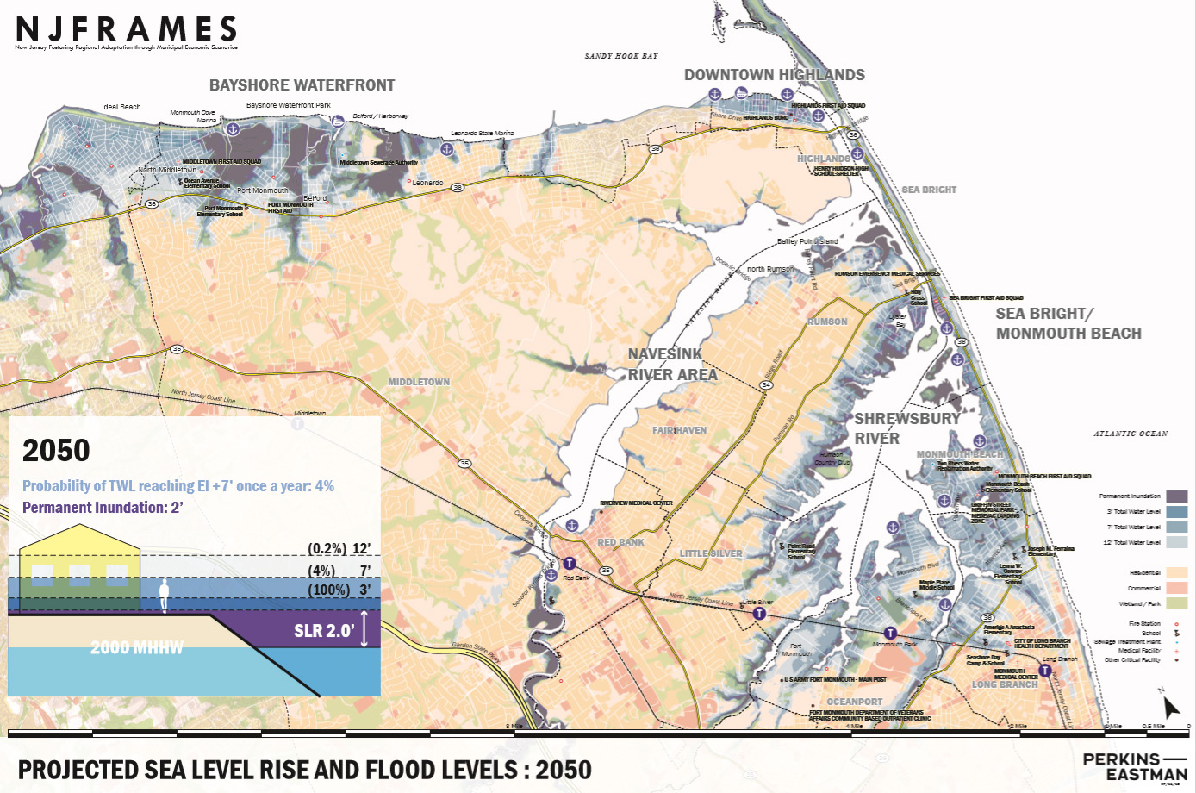
PROJECTED SEA LEVEL RISE-2050

Slide 4
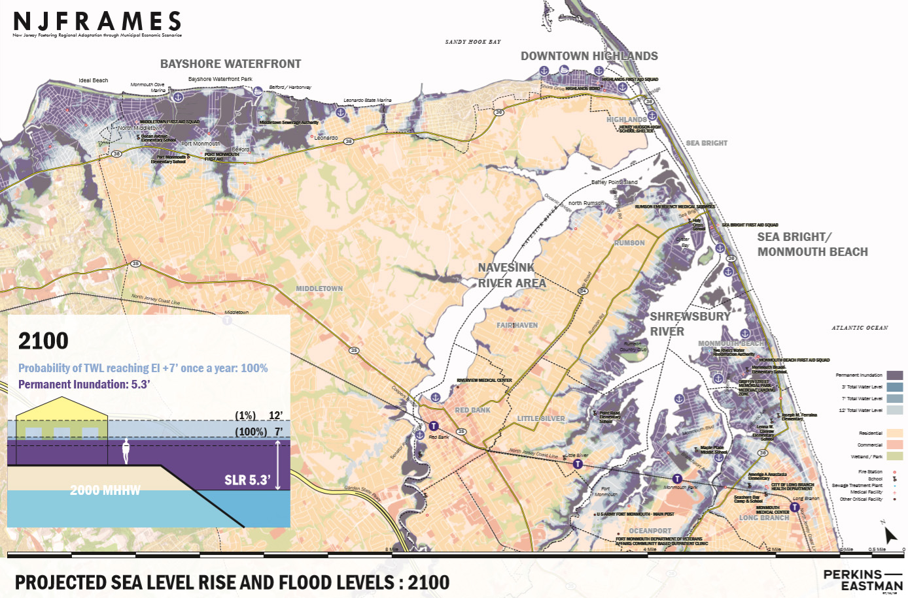
PROJECTED SEA LEVEL RISE-2100

Slide 5

NJ has goal of 7,500 MW from offshore wind by 2035
Notes:
A number of world’s countries have demonstrated they can switch to 100% wind and solar. Read “NJ goal of 3500MW….”In fact, I read those offshore sites have potential for further future expansion by 3 or 4 times the wind power.

Slide 6

NJ Top 6 Solar States: Solar Panels on 2 Million Homes
Notes:
NJ has dropped a little, but remains #6 in the nation in rooftop solar.

Slide 7
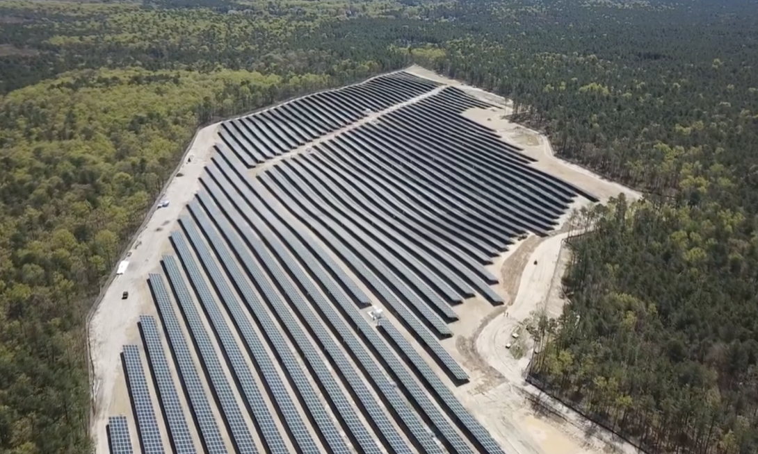
Solar at Six Flags Great Adventure
Notes:
Across NJ, we have companies like “KDC Solar”, who specialize in erecting immense solar fields, in partnership with large businesses. “KDC Solar” offers to erect solar systems, with no up-front cost, and then sell the electricity to the business at a BIG savings over JCP&L. This is called a “Purchase Power Agreement” or “PPA” – keep your eyes open- this is happening ALL OVER THE US.
It is very similar to a homeowner, renting their rooftop to a solar installer for $1. That installer then installs and owns the rooftop solar, and sells low cost electricity to the homeowner.

Slide 8
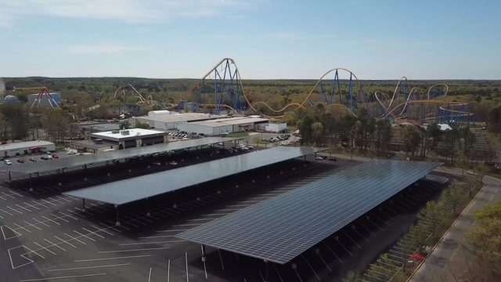
Six Flags Solar Canopy over Parking
Notes:
Similarly, Sea Brook Village in TintonFalls (15 acres of solar)
CentraState Hospital, Freehold (26 acres 6.3MW; 8.1 million KWH/Yr.)
In Middletown, we advocate for the Middletown train station parking to be covered with a solar Canopy, like the photo. The Middletown Administrator is using an energy consultant to look into pricing.

Slide 9
Middletown 2020 Energy Plan Goals
Make Middletown 100% clean energy by 2050
  As per NJ Global Warming Response Act
  As per NJ 2019 Energy Master Plan (released 1/27/20)
  So as to stave off the worst damage from Global Warming
Achieve Sustainable Jersey Gold Star in Energy
Notes:
Edit to introduce Energy Plan.

Slide 10

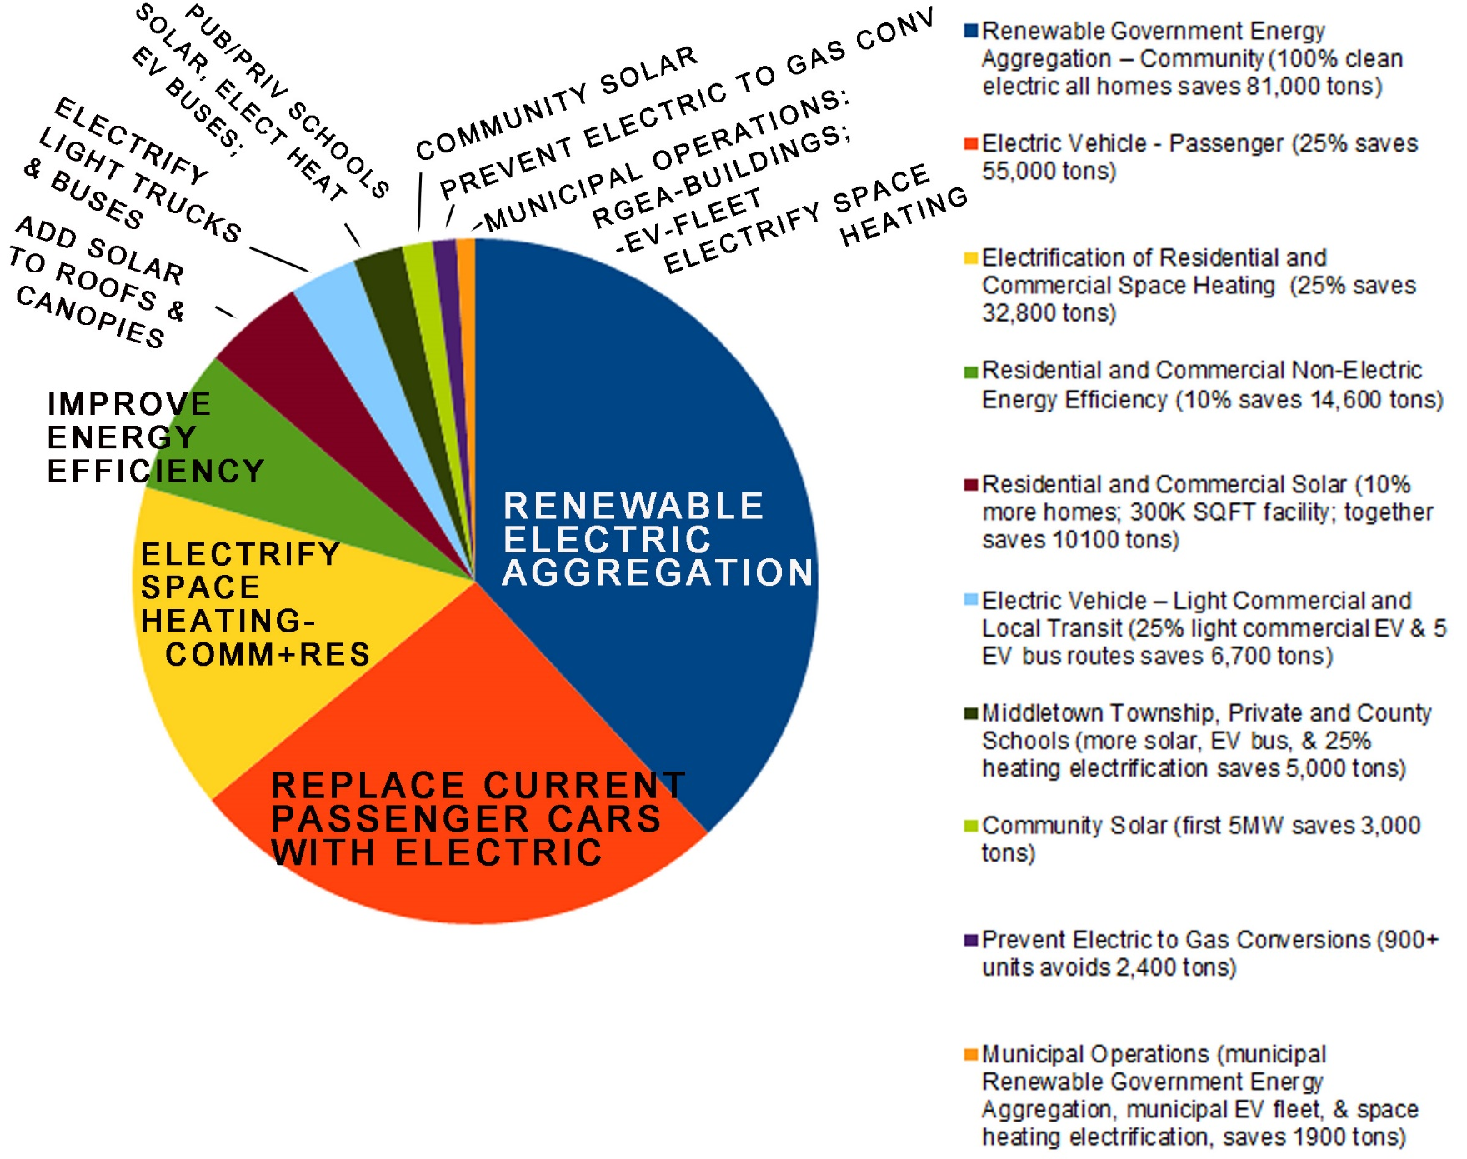
Middletown 2020 Energy Plan

Slide 11

Gold Star in Energy
Municipal Operations: Demonstrate GHG reduction of
  at least 3.6% per year
  for 3 years (10.8% over 3 years or less)
  “Municipal Carbon Footprint Action” at beginning and end
Community-wide emissions: Demonstrate GHG reduction of
  1% per year from entire community – residents, schools, businesses, industries, and municipal operations.
  6 specific Sustainable Jersey actions (or pre-approved substitutes) completed
Notes:
Edit to introduce Energy Plan.

Slide 12
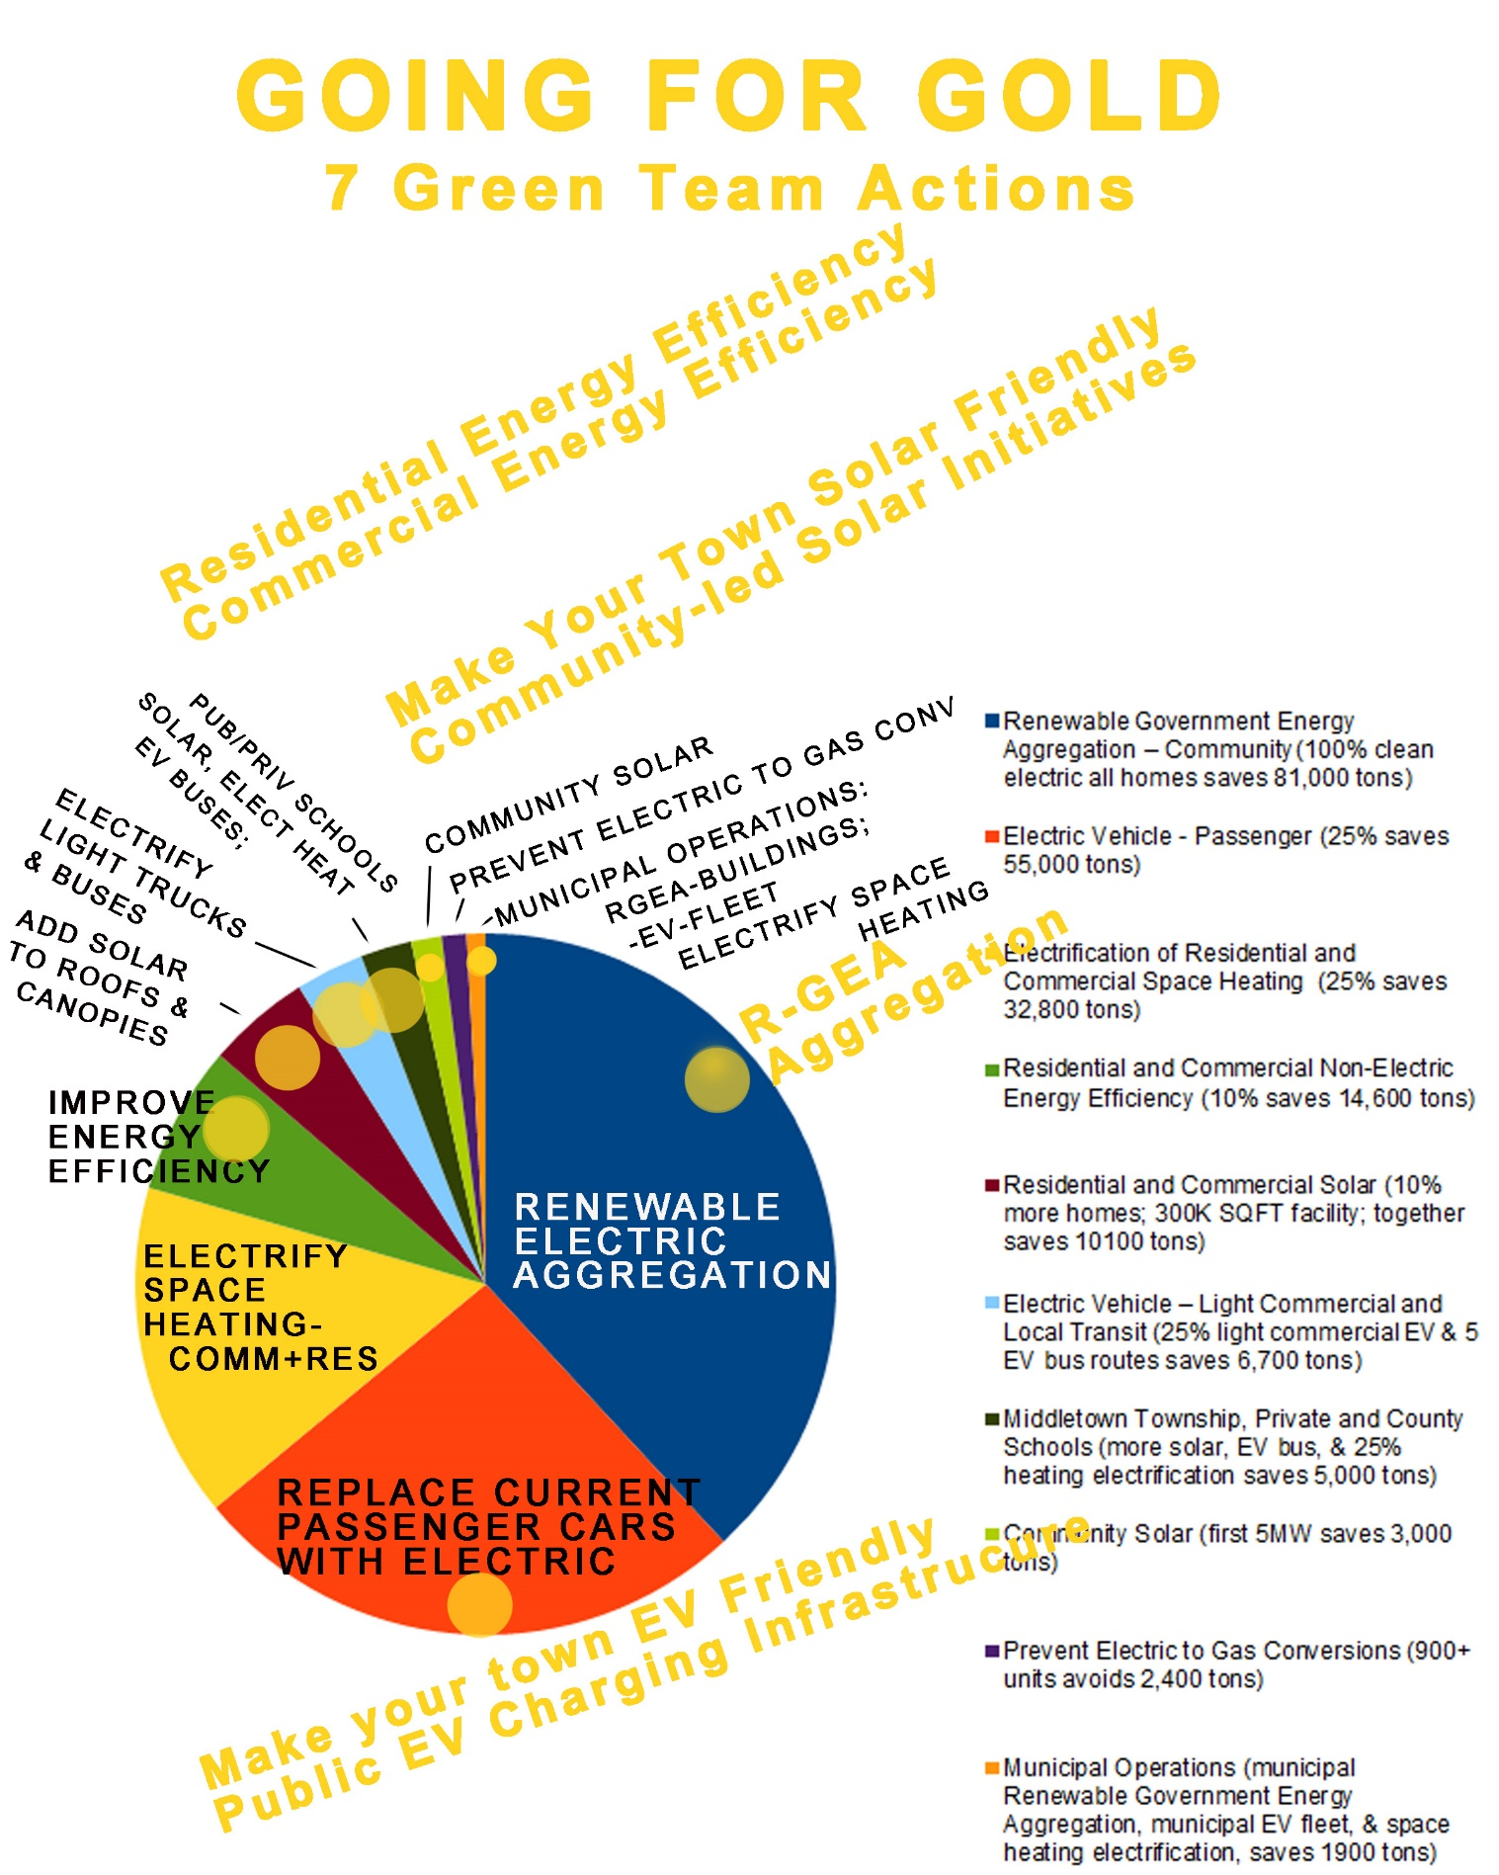
Middletown 2020 Energy Plan

Slide 13

New Jersey Renewable Government Energy (Electric) Aggregation (R-GEA) for Community
Most effective carbon reduction action: 40% of potential annual savings of all 2020 - 2030 actions
Provides cost savings to residents; low or no cost to Township

Slide 14
Renewable Community Choice
Electric Aggregation
Town purchases electricity with greater renewable content for residents
  Better price; guaranteed for life of contract
  Cleaner electricity; increasing to 100% by 2030
  More consumer protection
Renewables are now cheaper than natural gas or nuclear and falling (by 95% in last 20 years)
Notes:
Edit to introduce Energy Plan.

Slide 15
Renewable Community Electric Aggregation
Towns That Have Contracted Jun-July 2019
CITY | RENEWABLE CONTENT | RESIDENT SAVINGS
Essex Hub: South Orange, Glen Ridge, Maplewood, Montclair, Verona (PSE&G) | 41% | 10%
Glen Rock (PSE&G) | 100% | 8%
New Brunswick (PSE&G) | 2 options: 50% 100% | 10% 5%
Livingston: 2 (PSE&G) territories (JCP&L) | 100% ($.113/kwh) 41% ($.090/kwh) | $165 annual avg. 8%
Plainsboro (PSE&G) | 41% | $140 annual avg.
West Orange (PSE&G) | 100% | 5% - $45 annual avg.
Red Bank (JCP&L) | TBD (2 bids not meet reqmts) | TBD
Piscataway (PSE&G) – voted 11/5/19 | TBD | TBD
Notes:
Edit to introduce Energy Plan.

Slide 16
Renewable Community Electric Aggregation
How It Works for Residents
Town states desired terms; consultant goes out for bid.
Town chooses best supplier bid, enters 1-3 year contract.
Consultant provides customer support, incl. managing opt-ins & opt-outs & billing issues.
JCP&L provides physical grid/wiring service, & bills.
All residents are opted-in except
  Residents with home solar or 3rd party supplier contracts
  Businesses
All may change opt-in or opt-out at any time.
At end of contract, new bids are solicited.
Notes:
Edit to introduce Energy Plan.

